Slide 1

BANKRUPTCY PREVENTION GROUP NO : 2
GROUP MEMBERS :
Byrebanda Gireesh
Garnimitta Venkateswarlu
Baruri Manoj Nikhil Vishnu Teja
Tanguturi Sai Pravallika
Bhargavi Rageeru
Varun Ramavtar Pareek
Shital Manik Chavan

Slide 2
PROJECT ARCHITECTURE & PROJECT FLOW:
DEPLOYMET
Model Evaluation
Model Building
Exploratory Data Analysis
(EDA)
Data Preprocessing
Data understanding

Slide 3

Business objective:
The fundamental goal here is to model the probability that a business goes bankrupt.
To predict the likelihood of a company going bankrupt based on the provided features: industrial risk, management risk, financial flexibility, credibility, competitiveness, and operating risk.
Data-driven insights can help identify early warning signs and provide guidance for strategic decision-making

Slide 4
DATA SET DETAILS:
The dataset contains 7 columns and 250 rows
INDUSTRIAL RISK - 0=Low Risk, 0.5=Medium Risk, 1= High Risk.
MANAGEMENT RISK - 0=Low Risk, 0.5=Medium Risk, 1= High Risk.
FINANCIAL FLEXIBILITY - 0=Low Flexibility, 0.5=Medium Flexibility, 1= High Flexibility.
CREDIBILITY - 0=Low Credibility, 0.5=Medium Credibility, 1= High Credibility.
COMPETITIVENESS - 0=Low Competitiveness, 0.5=Medium Competitiveness,
1= High Competitiveness.
OPERATING RISK - 0=Low Risk, 0.5=Medium Risk, 1= High Risk.
CLASS – Bankruptcy, Non-bankruptcy (Target Variable)

Slide 5
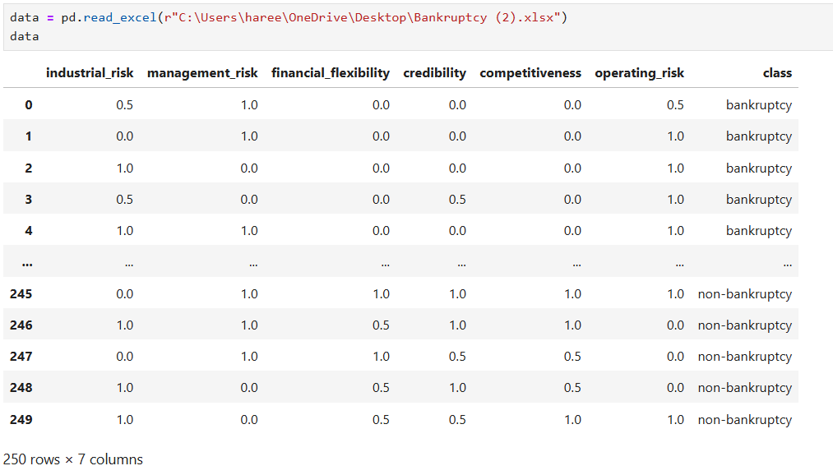
READING THE DATA:

Slide 6

EXPLORATORY DATA ANALYSIS(EDA)
Exploratory Data Analysis (EDA) is an approach that is used to analyze the data and discover patterns, or check assumptions in data with the help of statistical summaries and graphical representations; It can also help determine if the statistical techniques you are considering for data analysis are appropriate.

Slide 7
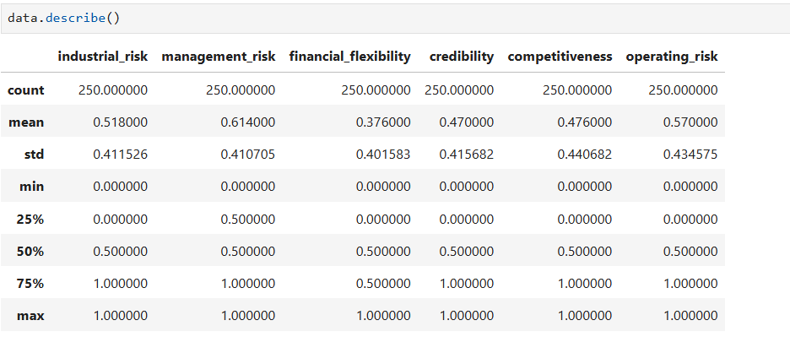
Insight of different statistical distribution of features and label:

Slide 8
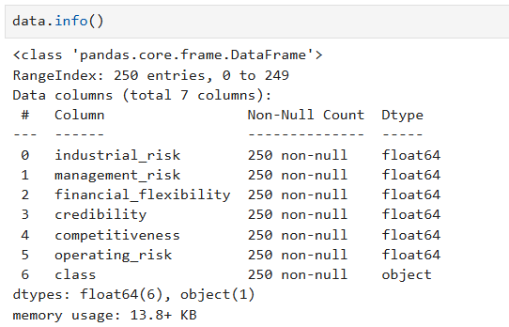
Checking Data types and Null values:

Slide 9
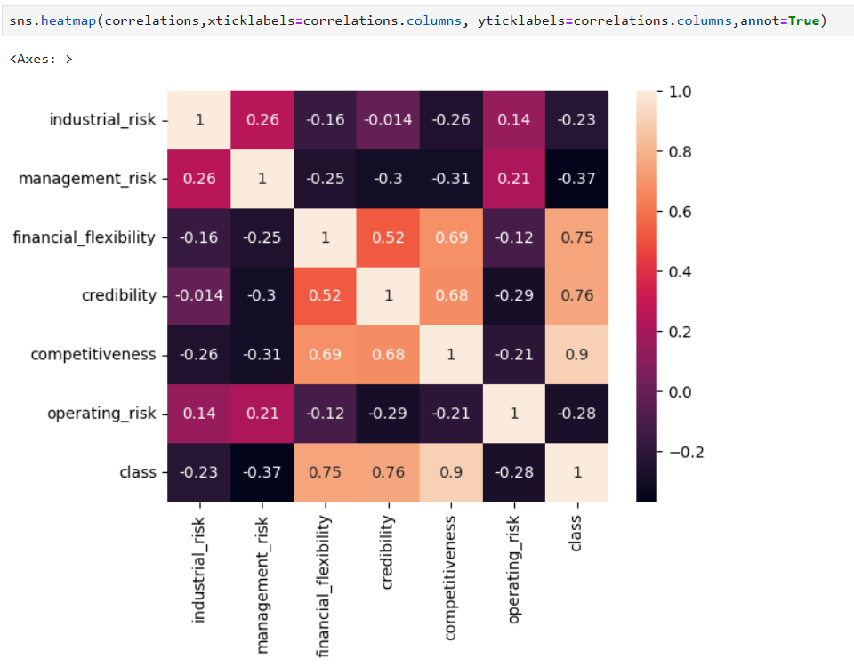
CORRELATION HEATMAP

Slide 10
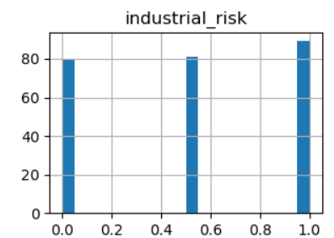
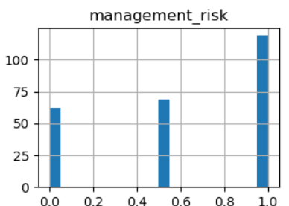
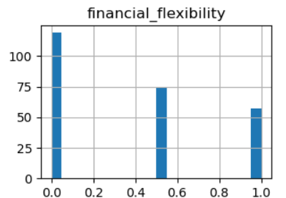
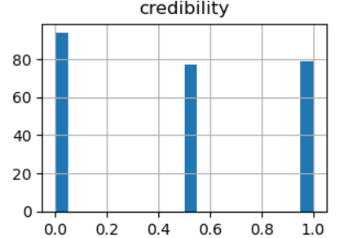
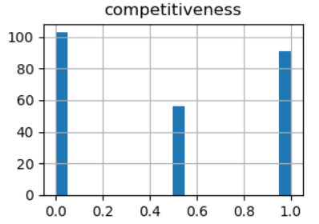
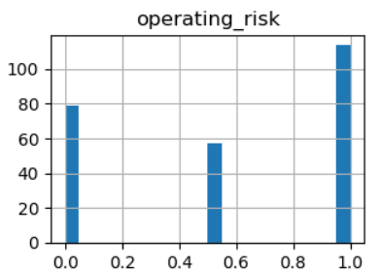
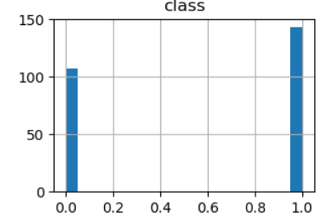
HISTOGRAM FOR WHOLE DATA SET

Slide 11
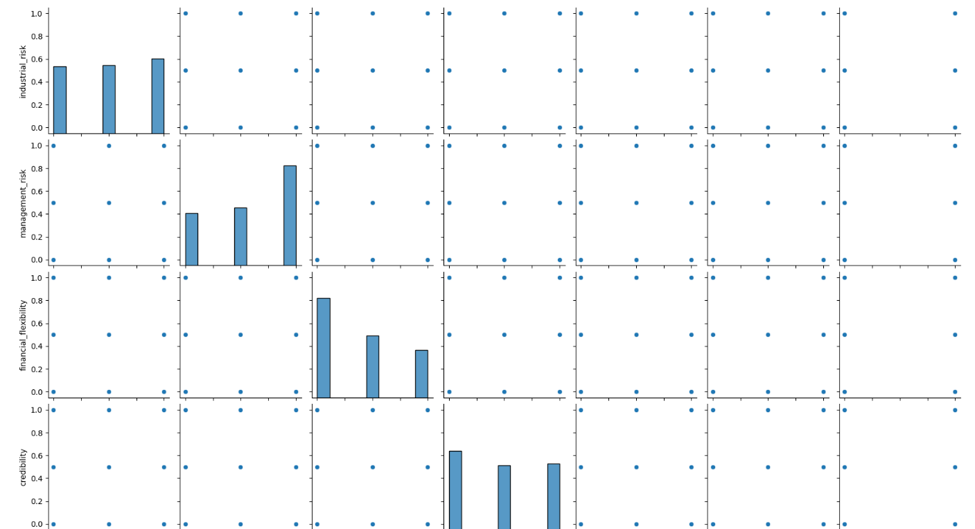
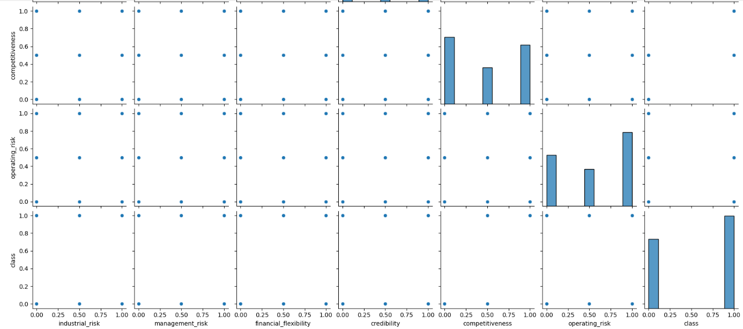
PAIRPLOT FOR WHOLE DATA SET

Slide 12
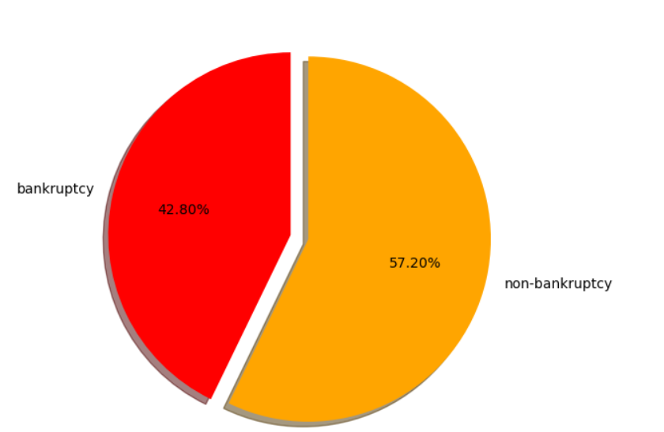
PIE CHART FOR WHOLE DATA SET

Slide 13
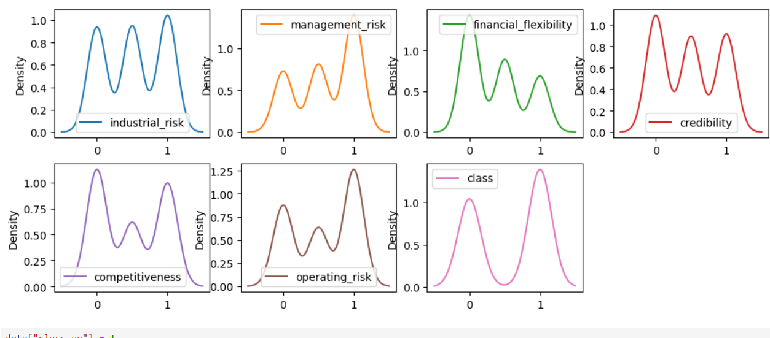
DENSITY PLOT FOR DATA

Slide 14
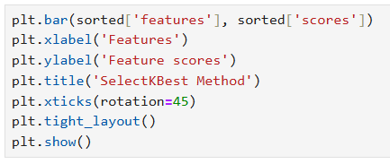
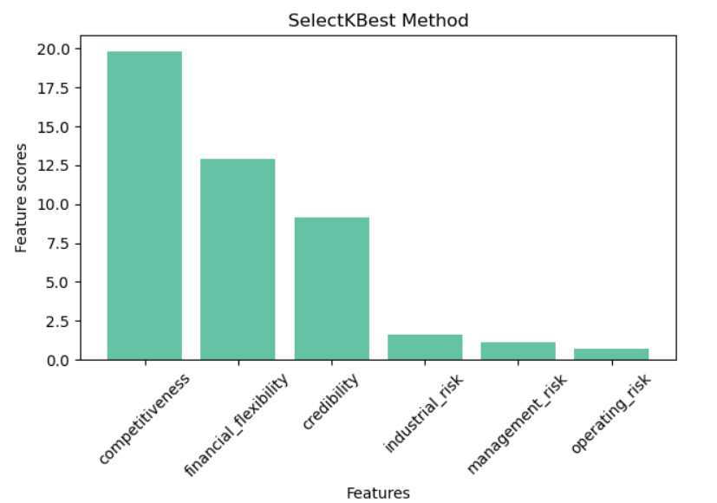
Feature Selection Using Select KBest Method

Slide 15
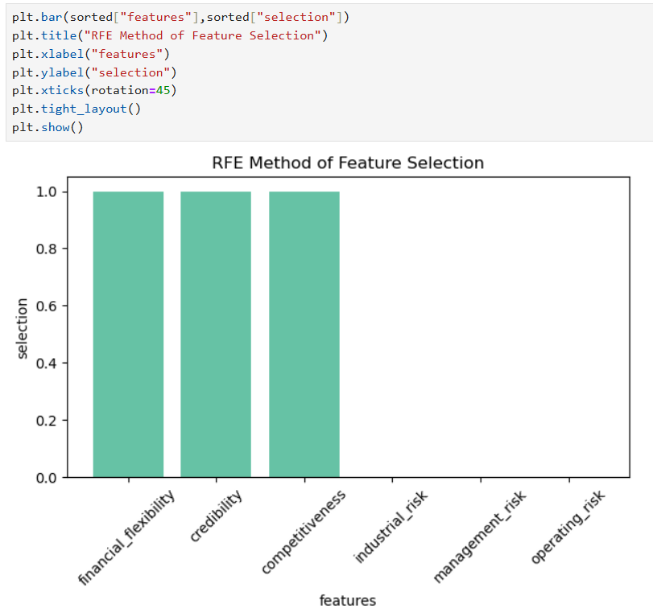
Feature Selection Using RFE (Recursive Feature Elimination)

Slide 16
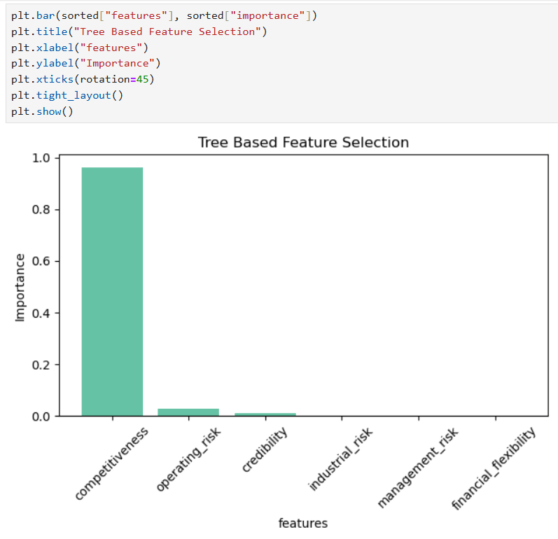
Tree Based Feature Selection

Slide 17
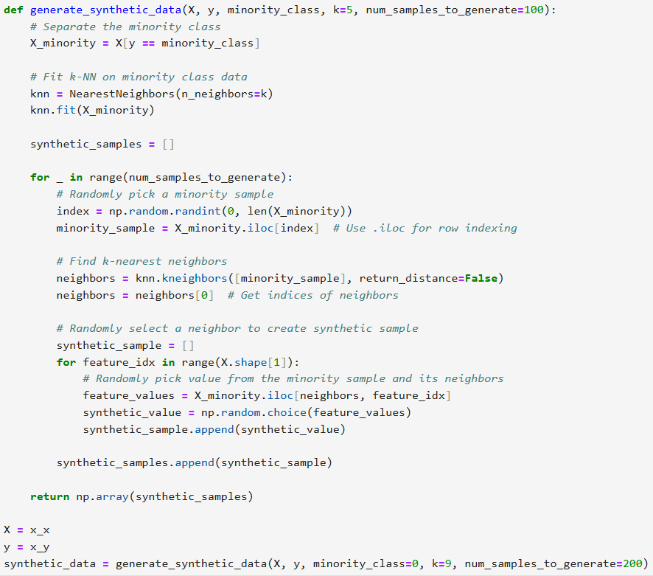
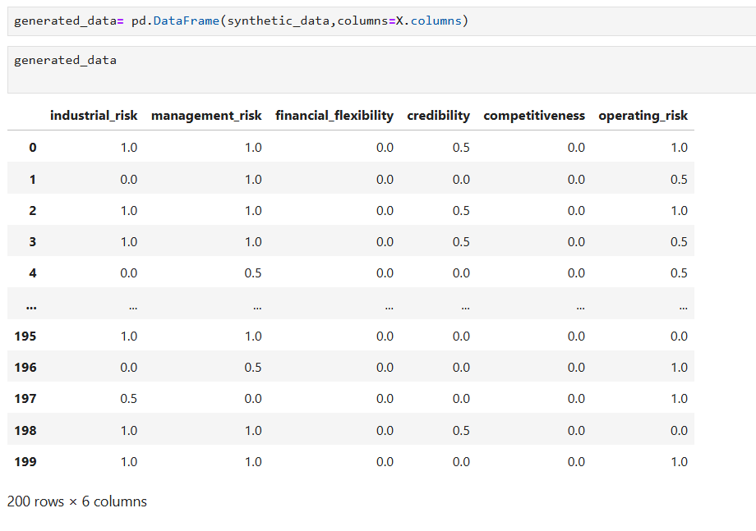
Handling Imbalance data using NN Method

Slide 18
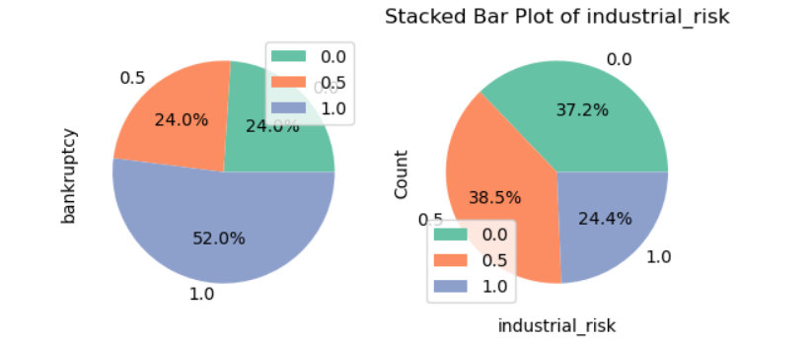
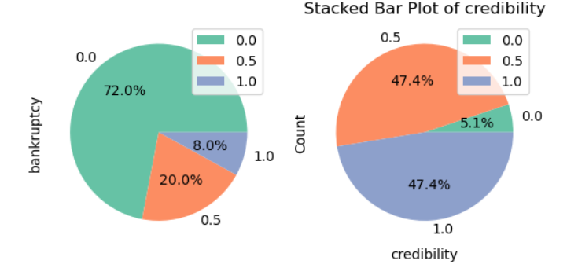
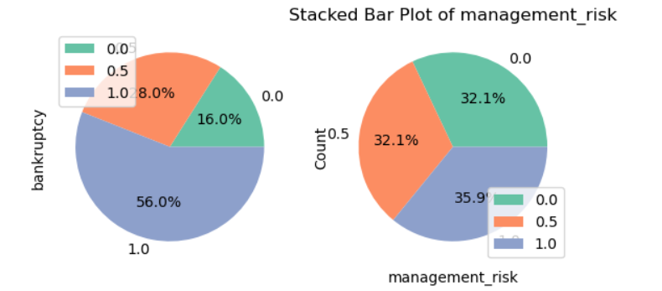
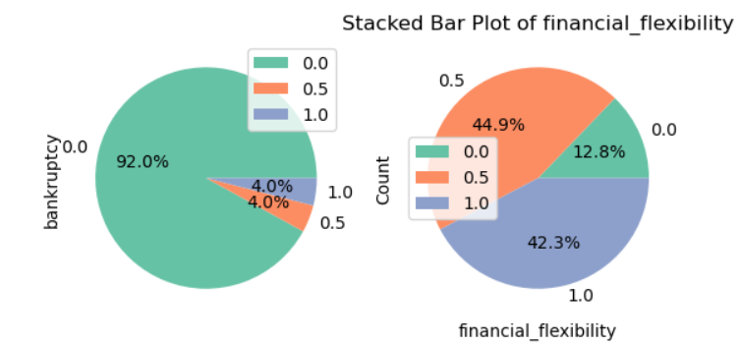
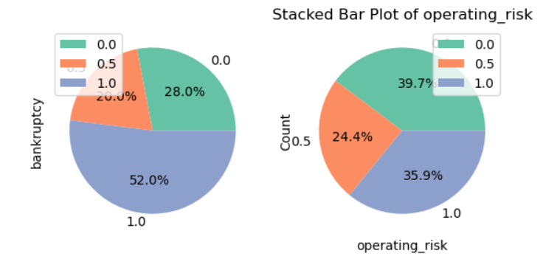
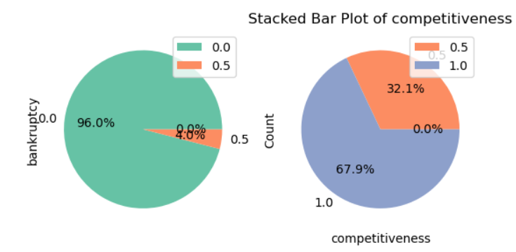
Handling Imbalance data using NN Method

Slide 19
Model Building
We have utilized various models to build our framework and employed a stacked model approach to integrate all of them effectively. This allows us to leverage the strengths of each individual model, enhancing overall performance and accuracy.
THE MODELS USED ARE:
LOGISTIC REGRESSION:
Simple and interpretable model for binary classification. Logistic regression is a statistical method for binary classification that predicts the probability of an outcome using the logistic (sigmoid) function. It provides interpretable coefficients as odds ratios and assumes a linear relationship between the log-odds of the outcome and predictor variables.
DECISION TREES:
A decision tree is a flowchart-like model used for classification and regression tasks. It splits data into branches based on feature values, leading to decision nodes and leaf nodes that represent outcomes. Decision trees are easy to interpret, handle both numerical and categorical data, and can capture complex interactions, but they may overfit if not properly pruned.

Slide 20
Model Building
ENSEMBLED TECHNIQUES:
Ensemble techniques improve predictive performance by combining multiple models. Methods like bagging (e.g., Random Forest) and boosting (e.g., AdaBoost) reduce errors and overfitting, leveraging the strengths of individual algorithms for better accuracy.
RANDOM FOREST:
Random Forest is an ensemble learning method that constructs multiple decision trees during training and merges their predictions for improved accuracy and robustness. It reduces overfitting by averaging the results of diverse trees, each built on random subsets of data and features. This method is effective for both classification and regression tasks, handling large datasets and maintaining high performance even with noisy data.
1.ADA BOOST :
AdaBoost (Adaptive Boosting) is an ensemble method that combines weak classifiers to form a strong classifier. It focuses on misclassified instances by adjusting their weights, improving accuracy through iterative training. This approach enhances model performance while reducing bias and is effective for various classification tasks.
2.GRADIENT BOOSTING :
Gradient Boosting is an ensemble technique that builds models sequentially, correcting errors from previous models. It optimizes a loss function using gradient descent, allowing flexibility with different data types. Effective for both classification and regression, it often achieves high performance. However, it requires careful tuning to prevent overfitting.

Slide 21
Model Building
3.XGBM:
XG Boost (Extreme Gradient Boosting) is an optimized gradient boosting framework known for its speed and performance. It includes regularization to reduce overfitting and supports parallel processing for efficiency. Widely used in competitions and applications, XG Boost is effective for both classification and regression, with customizable hyperparameters.
4.LGBM:
Light GBM (Light Gradient Boosting Machine) is an efficient gradient boosting framework optimized for speed and memory usage. It effectively handles large datasets and supports categorical features directly. Known for high performance in classification and regression, it often requires minimal tuning. Its design enables faster training and lower resource consumption, making it popular in competitions.
NAIVE BAYES :
Naive Bayes is a probabilistic classifier based on Bayes' theorem, assuming independence among features. It calculates the probability of each class given the input features and selects the class with the highest probability. This model is particularly effective for text classification and spam detection due to its simplicity and efficiency.
KNN:
K-Nearest Neighbors (KNN) is a non-parametric classification algorithm that assigns a class based on the majority class of its k nearest neighbors. While easy to implement, it can be computationally intensive for large datasets.

Slide 22
Model Building
SVM:
Support Vector Machine (SVM) is a supervised learning algorithm used for classification and regression tasks. It works by finding the optimal hyperplane that separates data points of different classes with the maximum margin. SVM can efficiently handle high-dimensional data and is effective for both linear and non-linear problems using kernel functions. It is particularly useful in applications like image recognition and bioinformatics.
NEURAL NETWORKS(ANN):
Artificial Neural Networks (ANNs) are computational models inspired by the human brain, consisting of interconnected layers of nodes (neurons) that process information. They learn patterns in data through training by adjusting weights based on input-output relationships. ANNs are versatile and can be used for tasks such as classification, regression, and image recognition. Their ability to capture complex relationships makes them powerful for various applications, including deep learning.
STACKED MODEL :
Stacked models, or stacking, is an ensemble learning technique that combines multiple base models to improve predictive performance. It involves training several different models (like decision trees, logistic regression, or neural networks) on the same dataset, then using their predictions as inputs for a higher-level model, often referred to as the meta-model. This approach leverages the strengths of diverse algorithms and helps mitigate individual model weaknesses. Stacking is effective in various applications, particularly in machine learning competitions where maximizing accuracy is crucial.

Slide 23
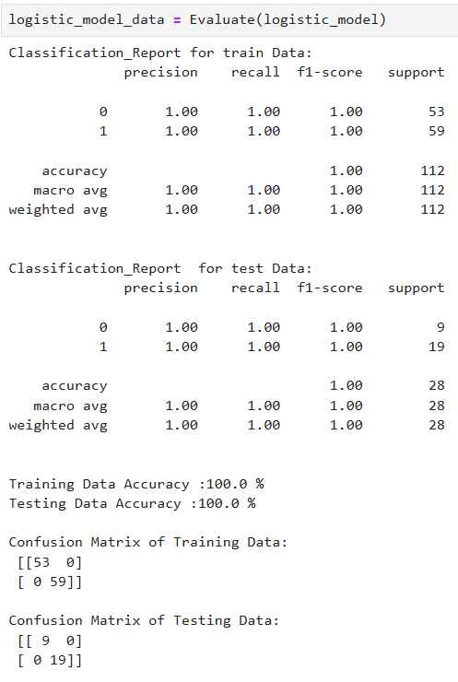
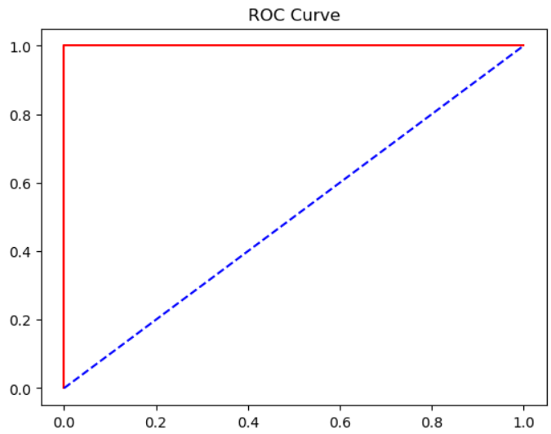
Logistic Regression Model
ROC CURVE for Logistic Regression Model

Slide 24
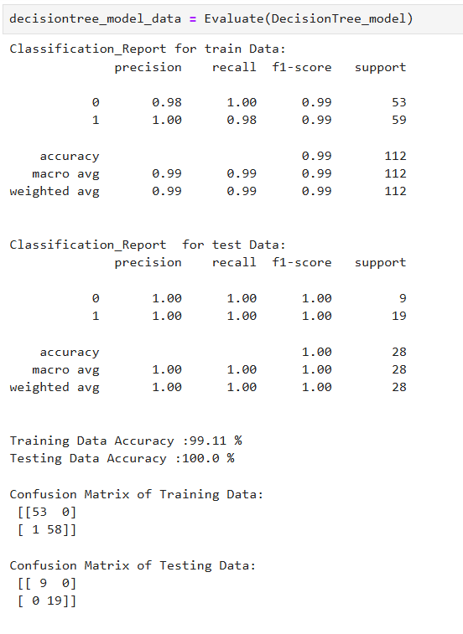
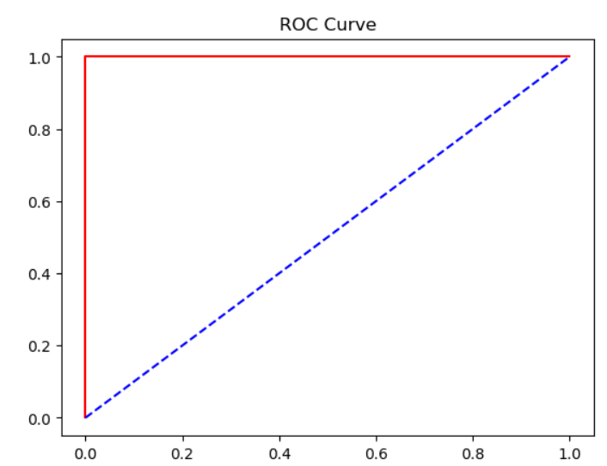
Decision Tree Model
ROC CURVE for Decision Tree Model

Slide 25
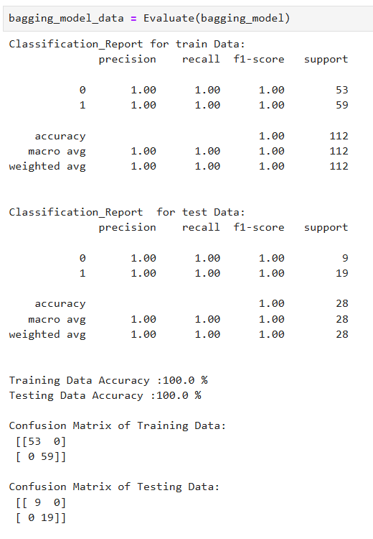
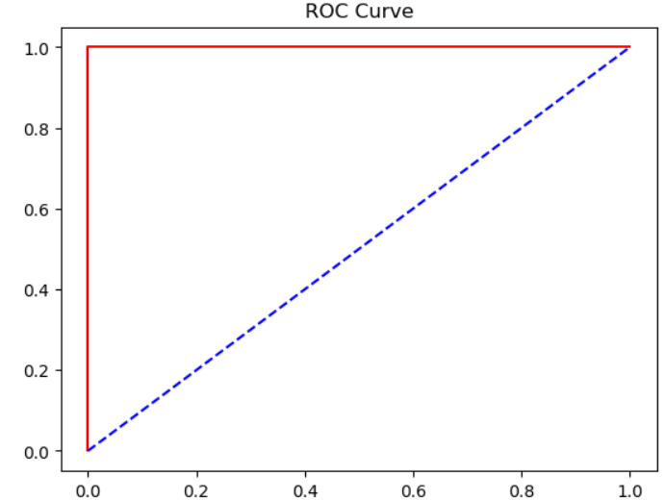
Bagging Model
ROC CURVE for Bagging Model

Slide 26
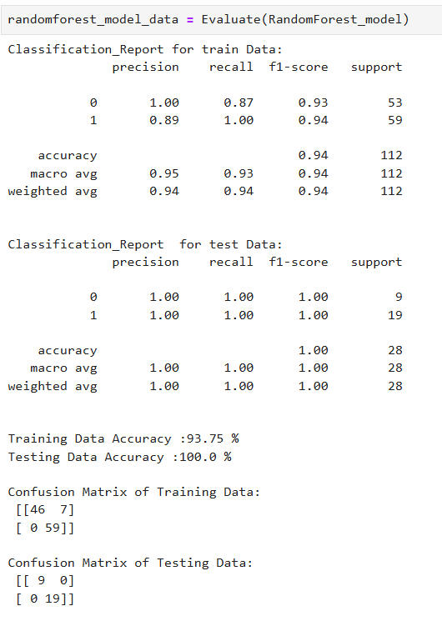
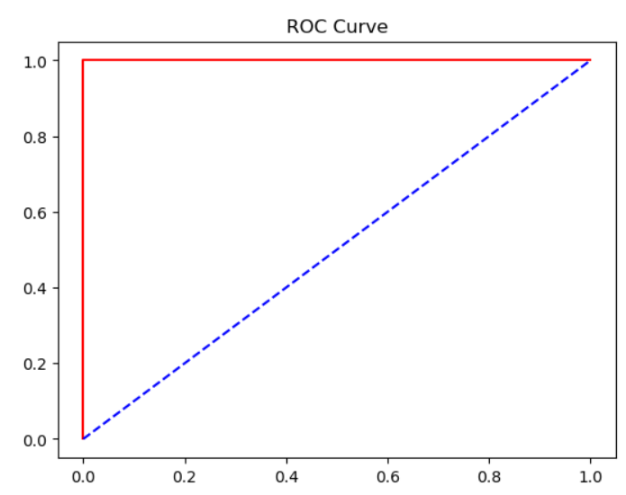
Random Forest Model
ROC CURVE for Random Forest Model

Slide 27
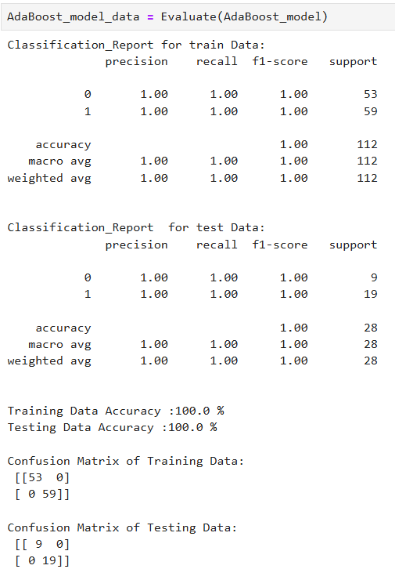
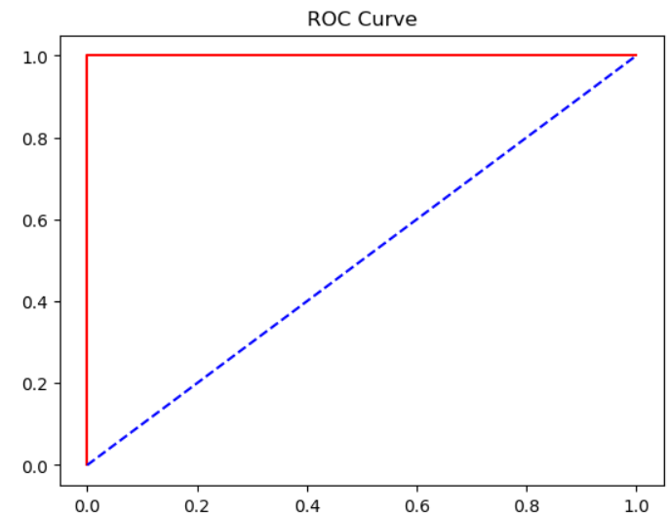
AdaBoost Model
ROC CURVE for AdaBoost Model

Slide 28
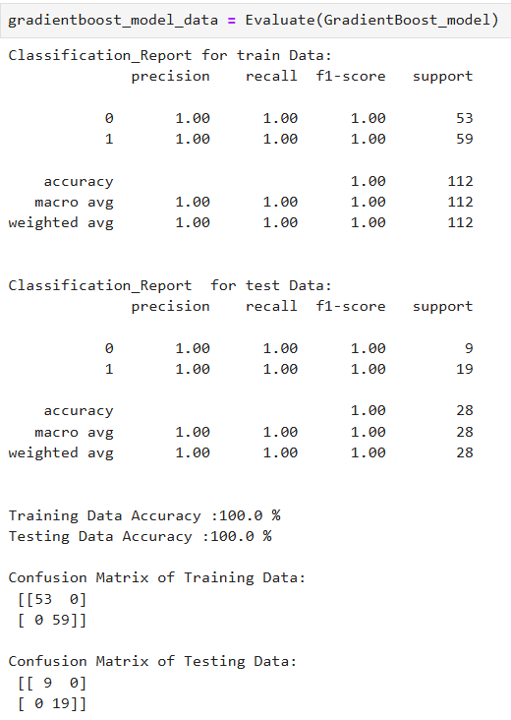

Gradient Boost Model
ROC CURVE for Gradient Boost Model

Slide 29


XG Boost Model
ROC CURVE for XG Boost Model

Slide 30
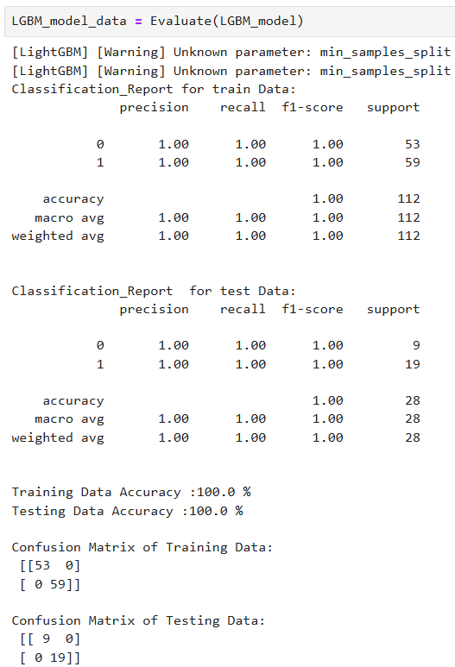
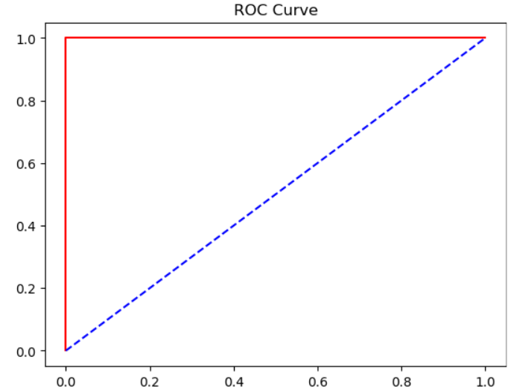
LGBM Model
ROC CURVE for LGBM Model

Slide 31
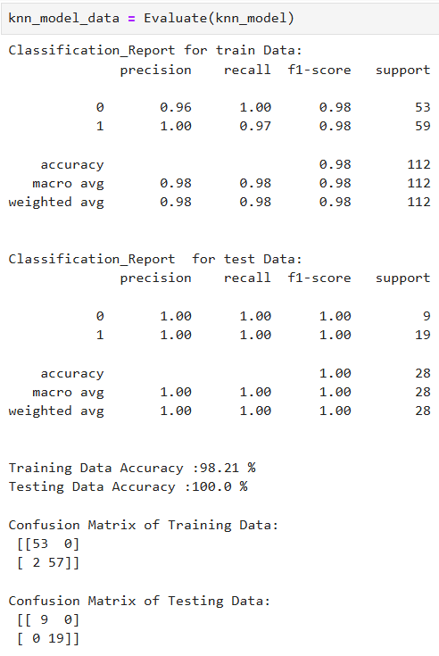
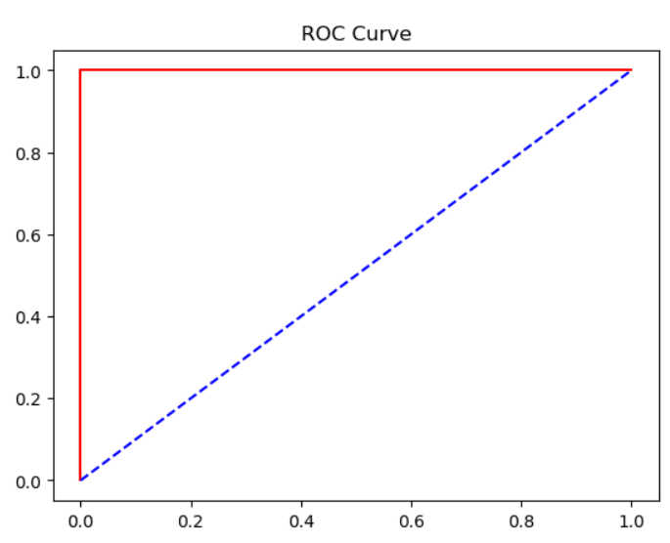
KNN Model
ROC CURVE for KNN Model

Slide 32
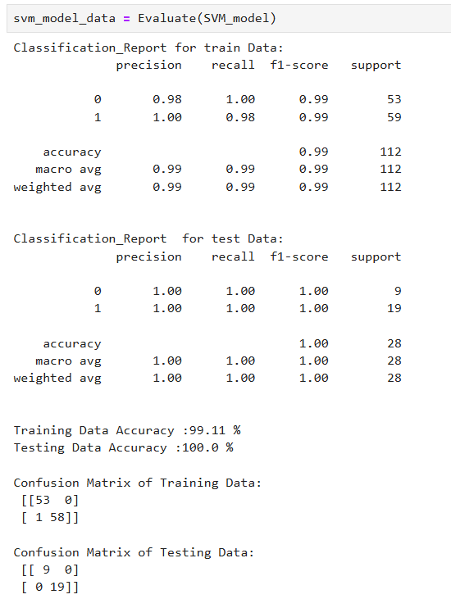
SVM Model

Slide 33
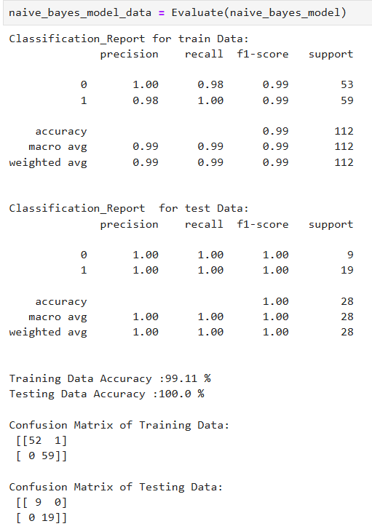
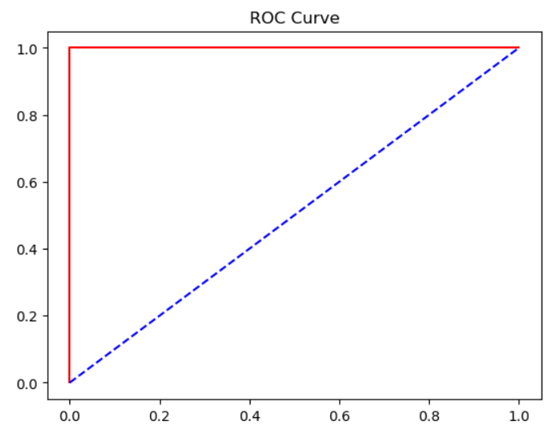
Naive Bayes Model
ROC CURVE for Naive Bayes Model

Slide 34
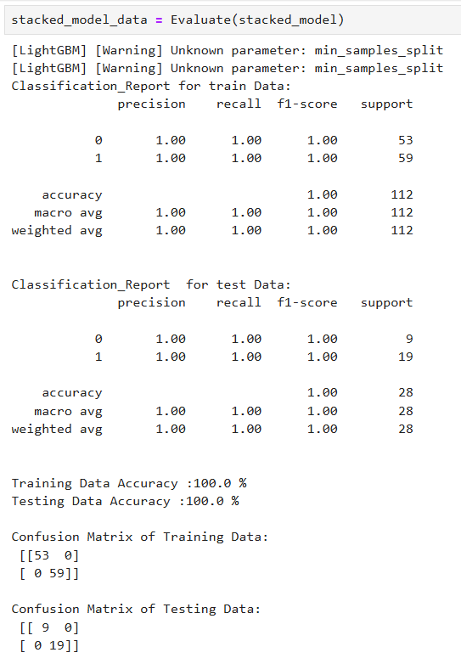
Stacked Model

Slide 35
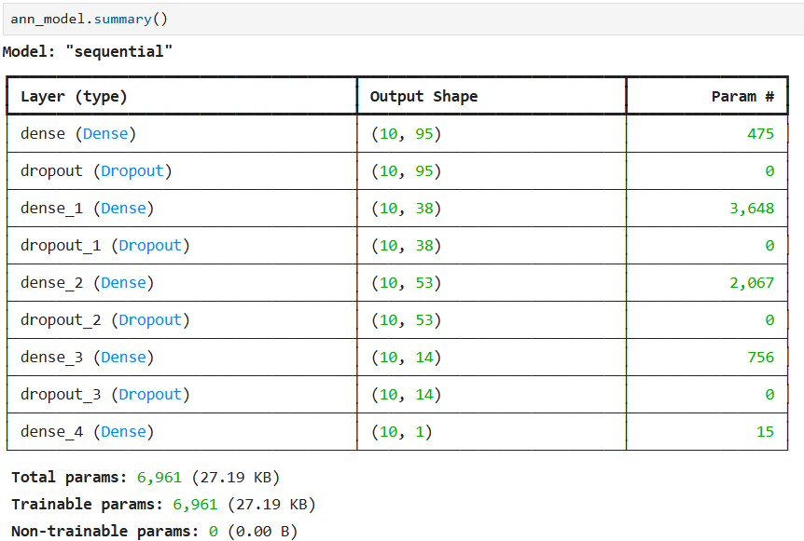
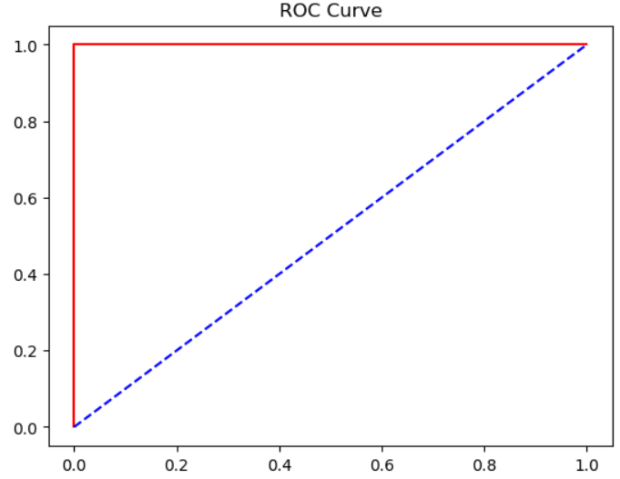
ANN Model
ROC CURVE for ANN Model

Slide 36
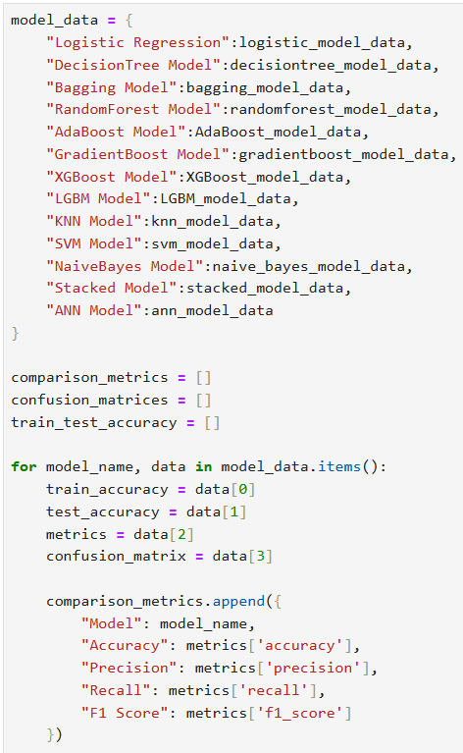
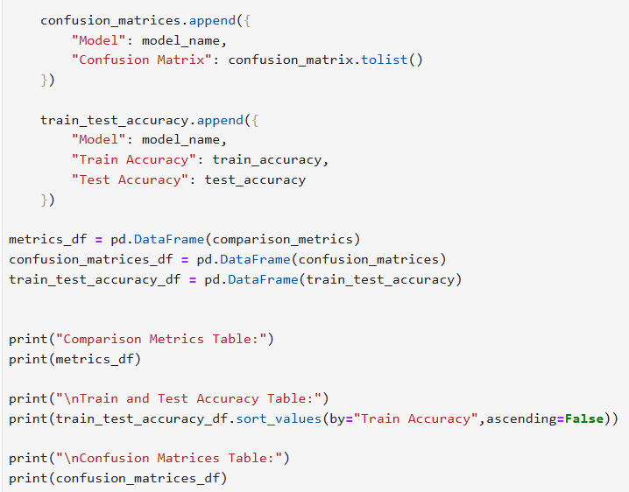
Comparing The Models

Slide 37



Comparing The Models

Slide 38



DEPLOYMENT
LOW RISK
MEDIUM RISK
HIGH RISK

Slide 39
Challenges faced?
The variables were Categorical Variables
Solution : Applied label encoding to convert categorical data into
numerical format.
Evaluation of Metrics, choosing appropriate evaluation metrics
Solution : Utilized methods like precision, recall, F1-score, and ROC
curve for comprehensive model evaluation.
Platform Selection for Deployment
Solution : Deployed the model on Streamlit Sharing for easy and free
hosting.

Slide 40


